Slide 1
Now we have the data… how do we analyze it?

Slide 2
Correlational Analyses

Slide 3
Correlational Research
Goal: examine and describe relationships between variables
No manipulation or control (i.e. observational)
Two or more measurements (variables)
Usually from the same individual
Identify patterns and measure strength of the relationship
Predict score on one variable based on the value of the other

Slide 4



Correlations:
Relationships between continuous variables
100
r = - 0.2
90
Grade in psychology lecture course
80
70
60
50
0
3
6
9
12
15
18
21
24
27
30
Minutes spent on laptop distractors during lecture

Slide 5
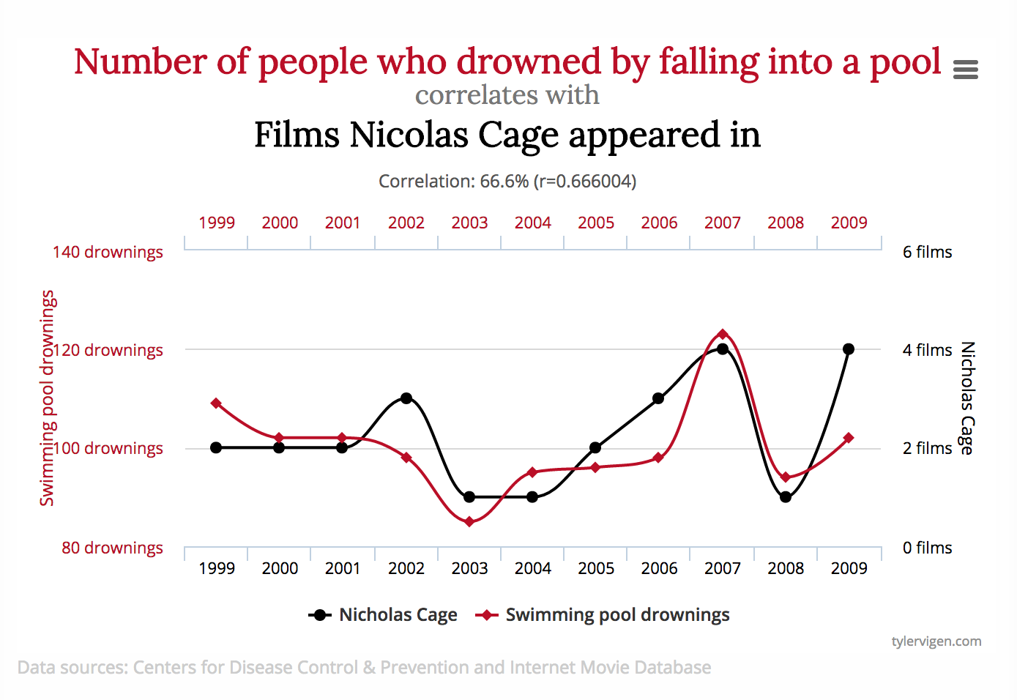

Slide 6
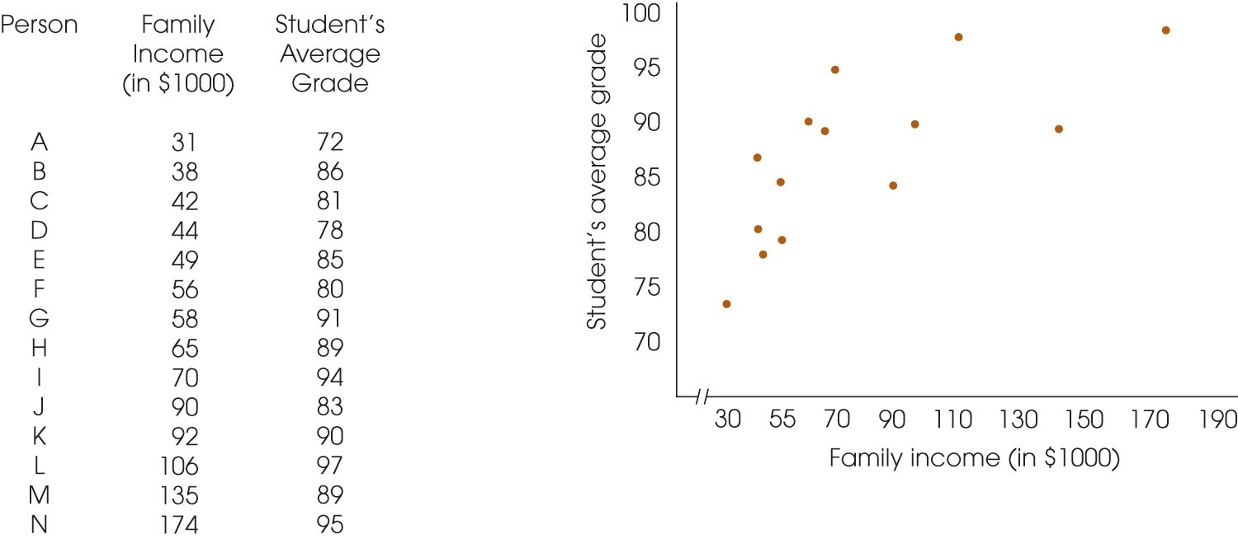
Data
Evaluating pairs of scores: Scatterplots

Slide 7
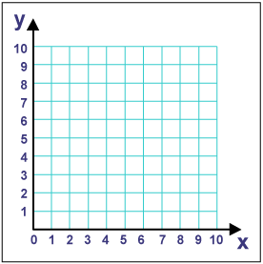
Graphing Relationships Between Variables
X-axis (abscissa)
Horizontal line
Values increase from left to right
Y-axis (ordinate)
Vertical line
Values increase from bottom to top

Slide 8
Correlation
Correlation – a standardized measure of how much two variables change together

Slide 9
The Correlation Coefficient
Describes three characteristics of the relationship between two variables:
Direction, strength, and form
Statistical Significance
Effect size (R² [coefficient of determination])
Percentage of variability in one variable that can be predicted by its relationship with the other variable

Slide 10
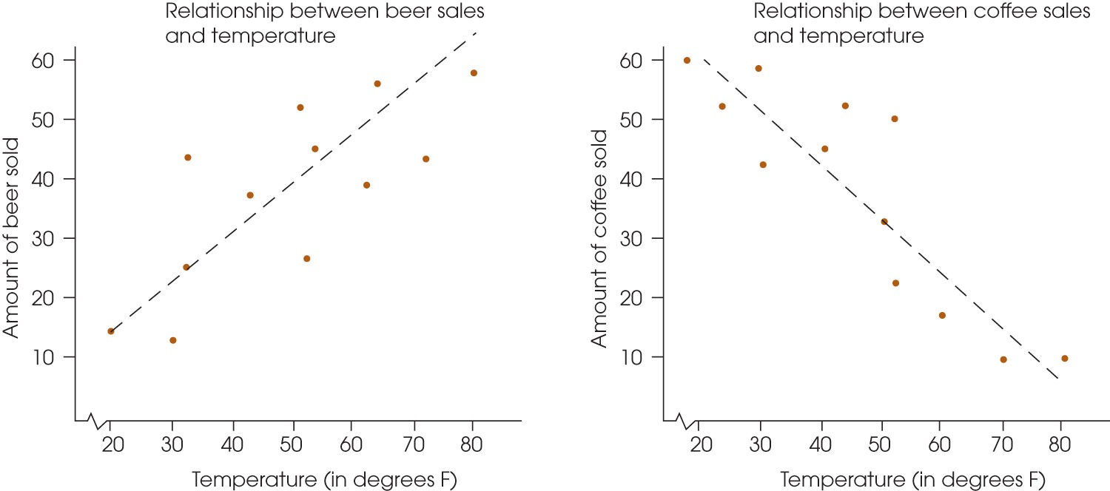
The Characteristics of a Relationship
The direction (“+” or “-”)

Slide 11
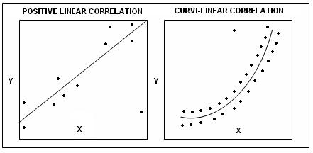
The Characteristics of a Relationship
The direction
The form (linear vs. curvilinear)

Slide 12
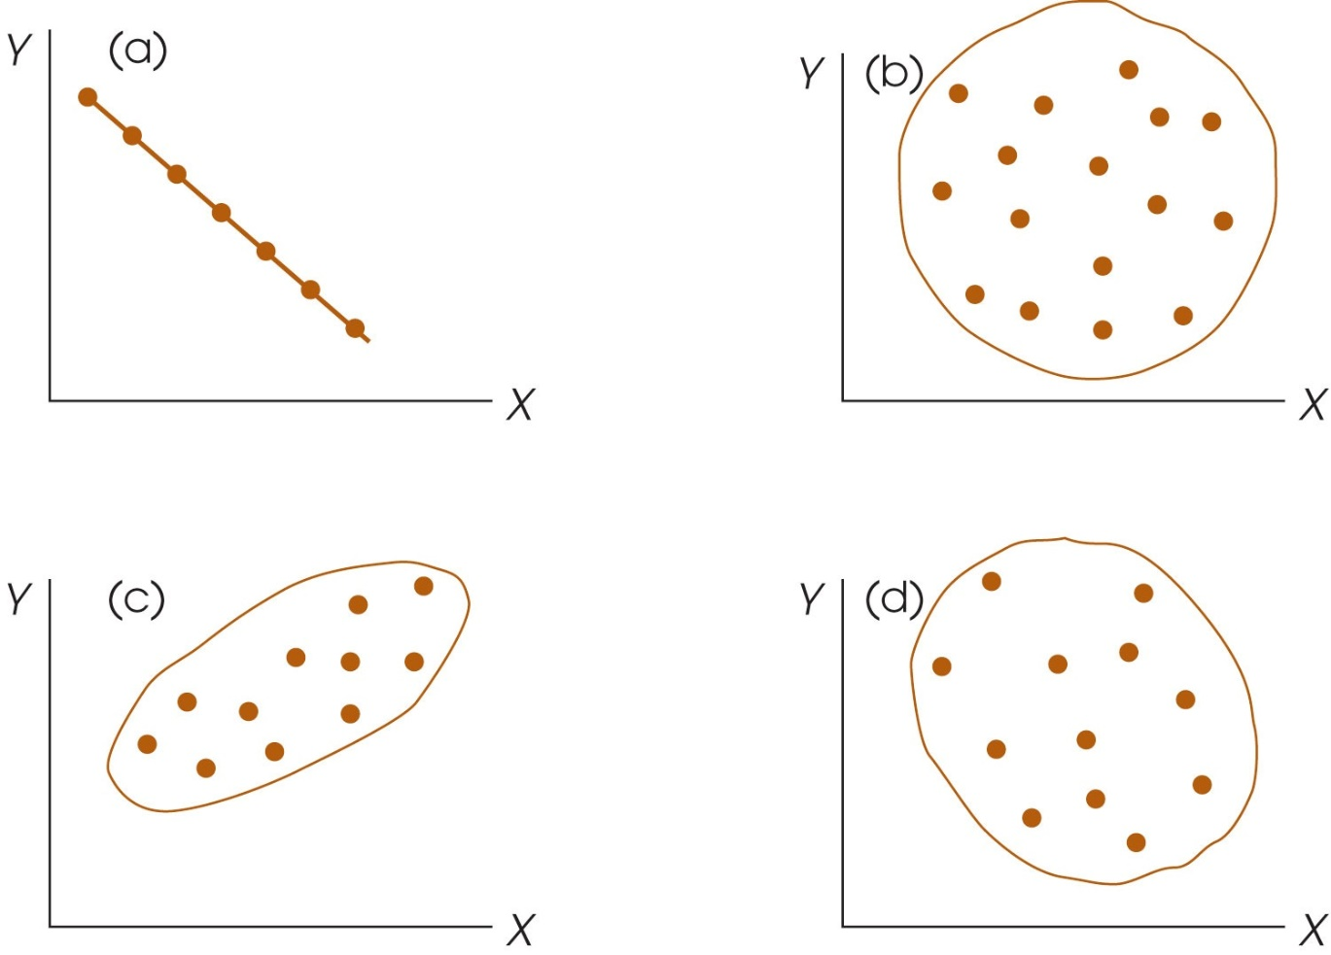
The Characteristics of a Relationship
The direction
The form
The strength
0.01 (very weak) to .99 (very strong)
1.00 = perfect correlation
0.00 = no correlation
Strong positive correlation
Weak negative correlation

Slide 13
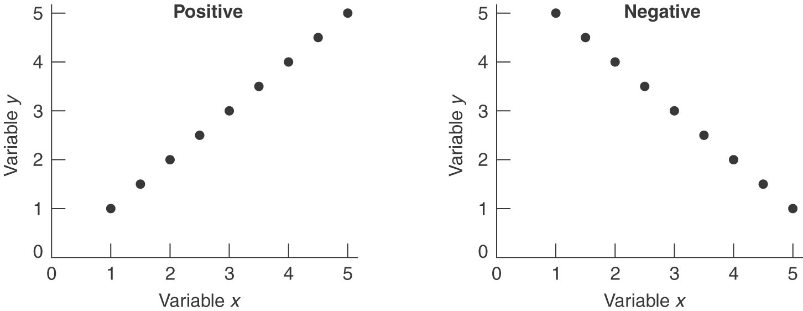
If you have a correlation coefficient of ±1.00:

Slide 14
Linear Correlations
Positive
Negative
90
r = -0.85
90
75
Null
(no correlation)
75
60
60
45
45
30
r = 0.8
30
15
r = 0
90
15
0
0
2
4
6
8
10
12
14
16
18
20
0
75
0
2
4
6
8
10
12
14
16
18
20
60
45
30
r = -0.33
90
15
90
75
0
75
60
0
2
4
6
8
10
12
14
16
18
20
60
45
45
30
r = 0.54
30
15
15
0
0
2
4
6
8
10
12
14
16
18
20
0
0
2
4
6
8
10
12
14
16
18
20

Slide 15
The Pearson Correlation (r)
Measures the degree and the direction of the linear relationship between two variables
It is also a ratio:
OR

Slide 16
Covariance
Covariance – a measure of how much two variables change together

Slide 17

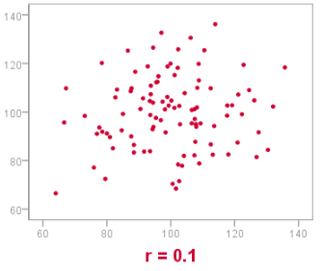
Visualizing correlations

Slide 18

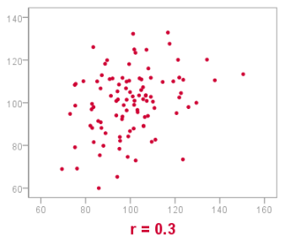
Visualizing correlations

Slide 19

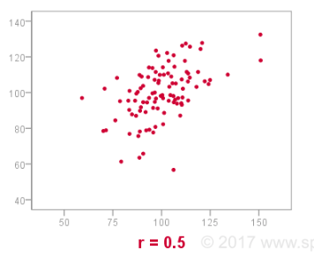
Visualizing correlations

Slide 20
Why Use Correlations?
To predict behaviors or events
Dr. Gajano hopes to demonstrate that celebrities who use more inhalable narcotics also tend to have more career failures than their peers. If this result is obtained, then what would be the predictor variable and what would be the criterion variable?
Predictor variable:
Criterion variable:
Use of inhalable narcotics
Career failure

Slide 21
Why Use Correlations?
To assess the reliability and validity of measures
Test-retest reliability: Does my new IQ test provide stable, consistent measurements over time?
Concurrent validity: Is my new IQ test a valid measure of intelligence

Slide 22
Why Use Correlations?
To evaluate theories of relationships between variables
Social learning theory of aggressive behavior
Is there a relationship between children seeing aggressive behavior and engaging in aggressive behavior?

Slide 23
Why Use Correlations?
To avoid ethical issues that make other designs unfeasible
Is there a link between smoking during pregnancy and low infant birth weight?

Slide 24
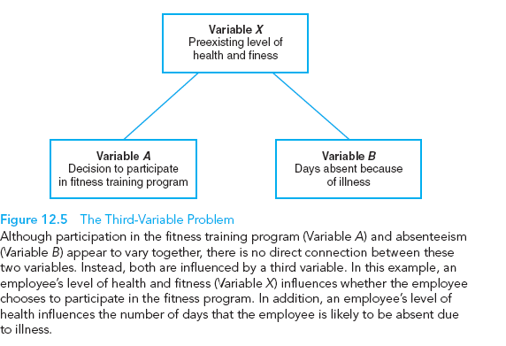
Correlation does not imply causation!
Correlations simply describe relationships
No experimental manipulation or random assignment of participants.
Third-variable problem Directionality problem

Slide 25
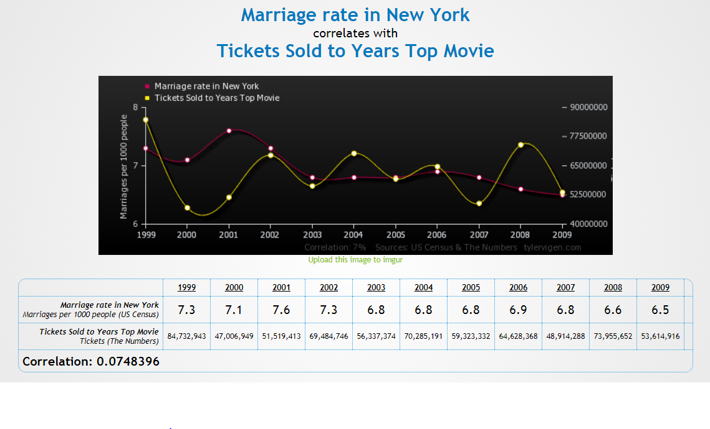

Slide 27
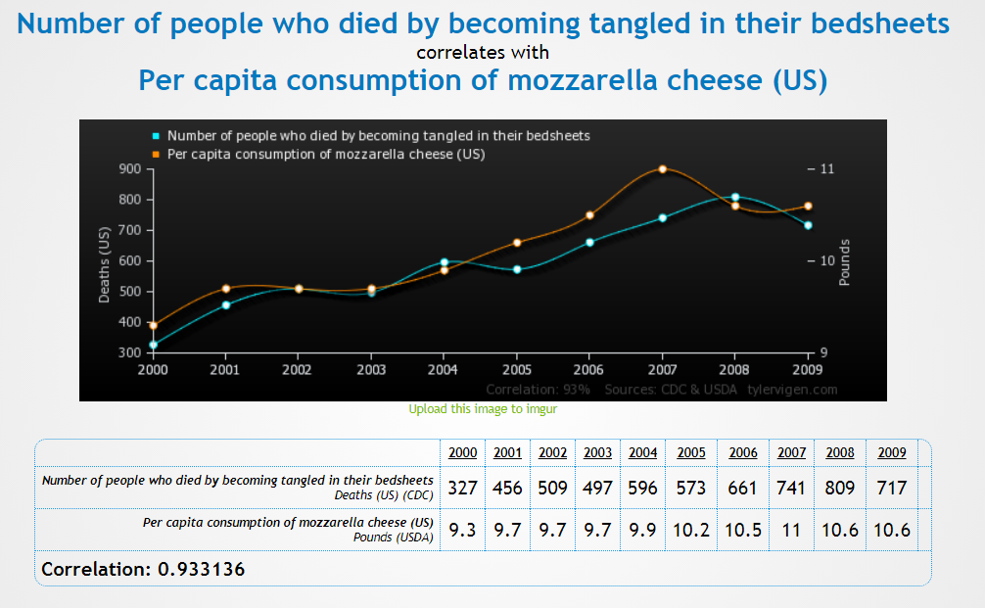

Slide 29
Effect size
Any time you find statistical significance, you always want to examine…

Slide 30
Effect Size
Refers to the strength of association between variables
Pearson r is one indicator of effect size
Advantage of reporting effect size is that it provides a scale of values that is consistent across all types of studies

Slide 31
R-squared
Sometimes it is easier to understand effect size in terms of a percentage
Squared value of the r coefficient transforms the value of r into a percentage
This is the percent of shared variance between the two variables

Slide 32
Regression

Slide 33
Regression Equations
a.k.a. Prediction equations
Calculations used to predict a person’s score on one variable when that person’s score on another variable is known
Y = score we wish to predict
X = score that is known
a = constant
b = weighing adjustment
Utilized when we are interested in predicting a future behavior (the criterion variable) based on the known variable (the predictor variable)
If X is X, then Y will be Y

Slide 34
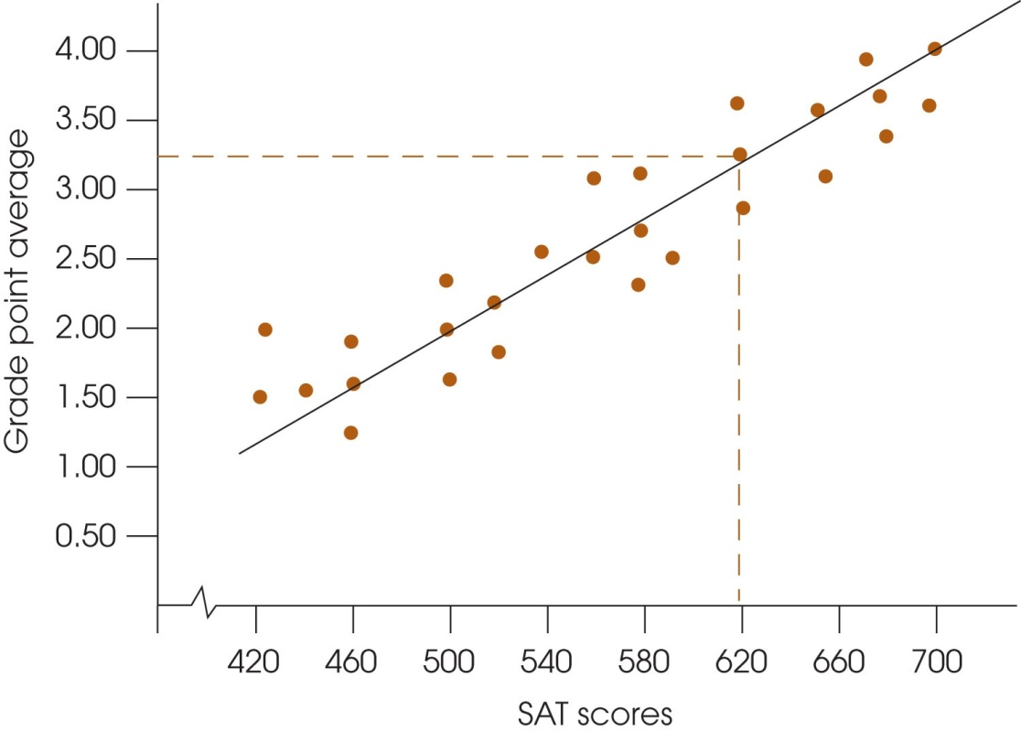
Regression
The statistical technique for finding the best-fitting straight line for a set of data
Allows us to make predictions based on correlations
A linear relationship between two variables allows the computation of an equation that provides a precise, mathematical description of the relationship
Regression Line

Slide 35
Correlation vs. Regression
While:
Both examine the relationship/association between two variables, and
Both involve an X and Y variable for each individual (one pair of scores)
There are differences in practice:
Correlation
Used to determine the
relationship between
two variables
Regression
Used to make predictions about one variable based on the specific value of another

Slide 36
Multiple Regression (R)
Used when there are more than two variables
One criterion variable can be explained/predicted from a set of predictor variables
Can control the influence of confounding variables (hierarchical regression)
Expressed as R (in contrast to r, for regression)

Slide 37
Multiple Regression (R)

